Slide 1
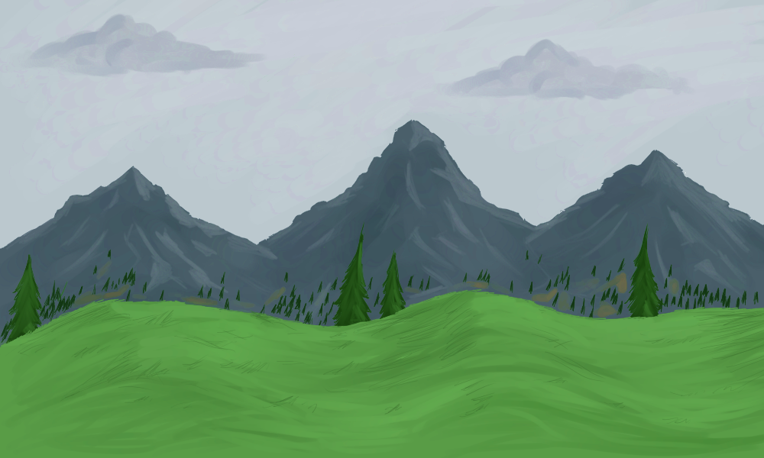




Observer no. 2, ready?
Start time: 9:30 am

Slide 2
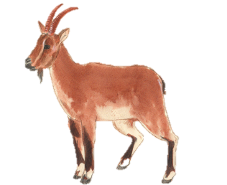
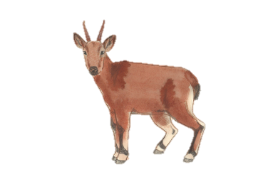
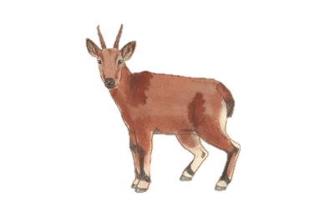
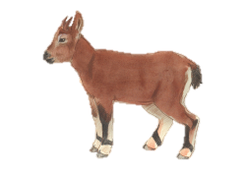

Observation no. 1
Time: 9:53 am
Location: Right-side middle 1st Ridge

Slide 3
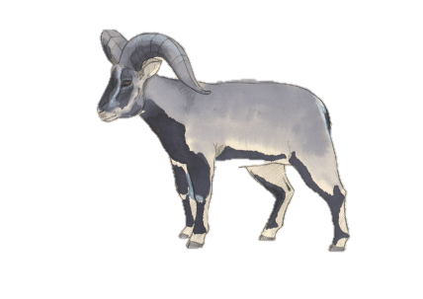
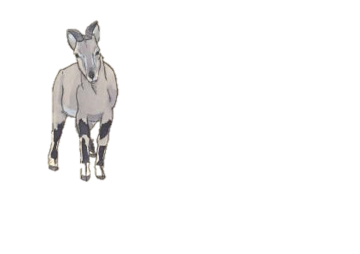
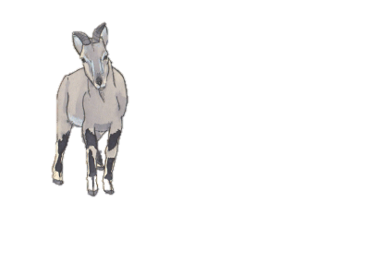

Observation no. 2
Time: 9:58 am
Location: Right-side bottom1st Ridge

Slide 4
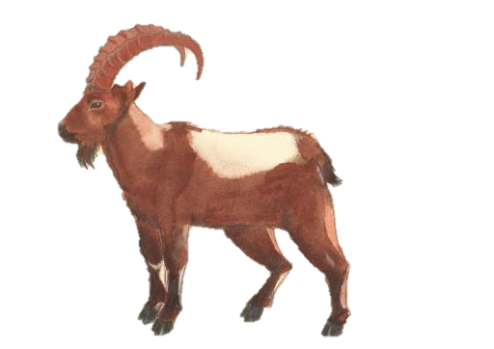
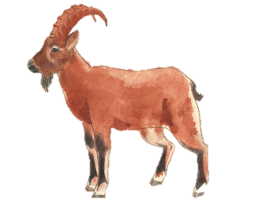
Observation no. 3
Time: 10:07 am
Location: Left-side top 2nd Ridge

Slide 5
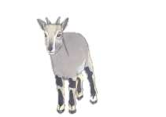
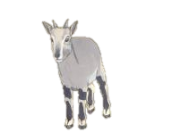
Observation no. 4
Time: 10:41 am
Location: Left-side middle 2nd Ridge

Slide 6
Observation no. 5
Time: 11:21 am
Location: Right-side top 3rd Ridge

Slide 7
Observation no. 6
Time: 11:46 am
Location: Right-side top 3rd Ridge

Slide 8
Observation no. 7
Time: 12:26 am
Location: Left-side bottom 4th Ridge

Slide 9
Observation no. 8
Time: 12:36 am
Location: Left-side top 5th Ridge

Slide 10
Observation no. 9
Time: 12:36 pm
Location: Left-side middle 6th Ridge

Slide 11
Observation no. 10
Time: 1:56 pm
Location: Left-side top 9th Ridge

Slide 12
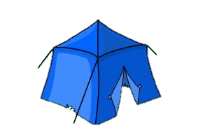
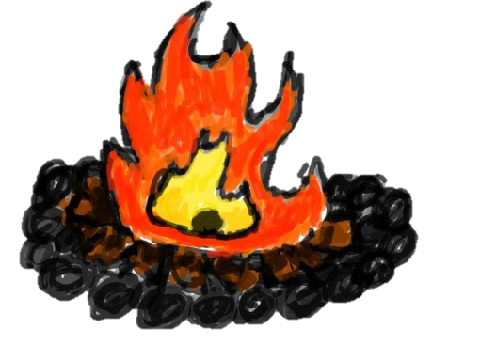
Observer 2, end
End time: 2:39 pm
Location: Ridge 12

